Slide 1
A ML Approach Using Statistical Models for Early Detection of Cardiac Arrest in Newborn Babies in the Cardiac Intensive Care Unit

Slide 2


Slide 3
ABSTRACT
Cardiac arrest in newborn babies is an alarming yet typical medical emergency. Early detection is critical for providing these babies with the best care and treatment. Recent research has focused on identifying the potential indicators and biomarkers of cardiac arrest in newborn babies and developing accurate and efficient diagnostic tools for early detection. An array of imaging techniques, such as echocardiography and computed tomography may help provide early detection of cardiac arrest. This research aims to develop a Cardiac Machine Learning model (CMLM) using statistical models for the early detection of cardiac arrest in newborn babies in the Cardiac Intensive Care Unit (CICU). The cardiac arrest events were identified using a combination of the neonate’s physiological parameters. Statistical modeling techniques, such as logistic regression and support vector machines, were used to construct predictive models for cardiac arrest. The proposed model will be used in the CICU to enable early detection of cardiac arrest in newborn babies.

Slide 4
Project Goal
The primary goal of this project is to develop a Cardiac Machine Learning Model (CMLM) using statistical models for the early detection of cardiac arrest in newborn babies within the Cardiac Intensive Care Unit (CICU).
This involves:
Identifying potential indicators and biomarkers of cardiac arrest in newborn babies.
Utilizing physiological parameters of neonates to detect cardiac arrest events.
Applying statistical modeling techniques such as logistic regression and support vector machines to construct predictive models.
Evaluating the effectiveness of these models using various performance metrics.
Implementing the most effective model in the CICU to enable timely intervention and improve patient outcomes.

Slide 5
INTRODUCTION
Cardiac arrest in newborns is a critical medical emergency requiring early detection to improve outcomes. This project utilizes statistical models to enhance early detection within the Cardiac Intensive Care Unit (CICU). By analyzing physiological parameters using logistic regression, Naive Bayes, KNN, Decision tree .Random Forest and Support Vector Machines (SVMs), the project aims to predict cardiac arrest risk early.
These models enable timely intervention and optimize care for vulnerable newborns, potentially reducing mortality rates and improving neonatal health outcomes.

Slide 6
Symptoms associated with newborn baby cardiac arrest
Rapid Heart Rate : Newborns experiencing cardiac arrest may have an unusually fast heart rate.
Difficulty Breathing: Difficulty breathing or rapid, shallow breaths be indicative of cardiac distress.
Bluish Skin Tone: A bluish tinge to the baby’s skin, especially around the lips or extremities, may indicate poor oxygen circulation due to cardiac arrest.
Unresponsiveness or Decreased Movement: If the baby is unresponsive or shows decreased movement.

Slide 7
What's a Normal Heart Rate?
Heart rate is measured by counting the number of beats per minute. Someone's normal heart rate depends on things like the person's age and whether they lead an active lifestyle.
The resting heart rate decreases as kids get older. Typical normal resting heart rate ranges are:
babies (birth to 3 months of age): 100–150 beats per minute
kids 1–3 years old: 70–110 beats per minute
kids by age 12: 55–85 beats per minute

Slide 8
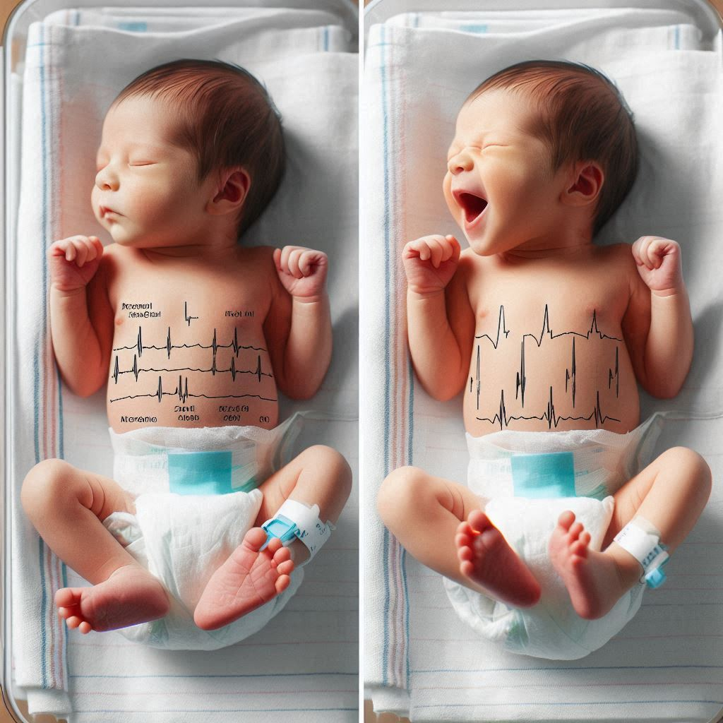

Slide 9

Risk Factors
Risk factors that increase the likelihood of cardiac arrest in newborn babies:
Congenital Heart Defects
Premature Birth and Low Birth Weight
Infections
Metabolic Disorders
Respiratory Distress Syndrome
Birth Asphyxia
Genetic Disorders
Maternal Health Issues
Medication Exposure
Family History

Slide 10
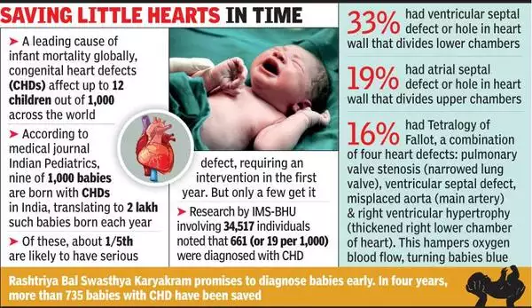

Slide 11
To ensure early detection of cardiac arrest in newborn babies, regular monitoring of their heart rate and respiratory rate is crucial. This can be achieved through:
Pulse Oximetry:
Method: Non-invasive measurement of blood oxygen levels using a sensor attached to the baby's skin.
Benefits: Provides continuous monitoring to detect respiratory distress or inadequate oxygenation early.
Auscultation:
Method: Listening to the baby's heart and breath sounds using a stethoscope.
Benefits: Allows healthcare providers to detect irregularities in heart rate or breathing patterns.

Slide 12
CURRENT SYSTEM
According to Carlisle, M. A., et al. , heart failure happens when the heart capacity to pump blood is low, which frequently results in various diseases. Heart failure can also result from an abnormal heartbeat known as atrial fibrillation. Medications, lifestyle modifications, and even surgery are all part of the treatment process.
According to Yaku, H., Along with higher rates of re-hospitalization, this decline may result in lengthier stays, greater healthcare utilization, death, and a lower quality of life.
The Vasoactive-Inotropic Score (VIS), which forecasts morbidity and death in newborns following cardiopulmonary bypass, was covered by Gaies, M.G., et al.
Cardiac failure with intact or reduced ejection fraction, which is characterized by compromised cardiac function, was covered by Lee, D. S., et al. Risk factors include gender, age, obesity, smoking, and alcohol intake. The causes include disorders like diabetes, hypertension, and coronary artery disease.

Slide 13
Disadvantages of current system
Complexity of Data: Models must interpret large, complex datasets, requiring advanced techniques like deep learning and feature engineering.
Data Availability: Sufficient, high-quality data is crucial. Solutions include data augmentation, synthetic data, and combining datasets from multiple sources.
Incorrect Labeling: Model accuracy depends on correct data labeling. Ensuring accuracy involves expert validation and robust preprocessing.
Overfitting: This occurs when models capture noise instead of patterns. Mitigation techniques include cross-validation, regularization, pruning, and ensembling.
Model Selection: Choosing the right model is critical. It requires understanding the problem domain, experimenting with various models, and using evaluation metrics.

Slide 14
Proposed System
Building a Cardiac Machine Learning Model involves several key steps. First, data collection and preprocessing are essential, involving the gathering of patient information such as age, gender, heart rate, oxygen level, and blood pressure followed by cleaning and converting this data into formats suitable for machine learning algorithms. Next, selecting and training the model is critical. The model is trained and evaluated, with adjustments made to improve accuracy. Implementation involves developing an interface for medical practitioners to use the model and regularly monitoring and adjusting the model to maintain accuracy. Data integration and analysis follow, where patient symptoms and data are categorized and stored, and severity predictions guide treatment decisions. Key processes include feature extraction to convert raw data into meaningful features and data preprocessing to remove noise and handle missing values. Finally, the model is utilized to detect and categorize cardiac anomalies, providing rapid and reliable diagnosis and prediction of heart problems, thus supporting medical practitioners in diagnosing and treating cardiac conditions efficiently.

Slide 15
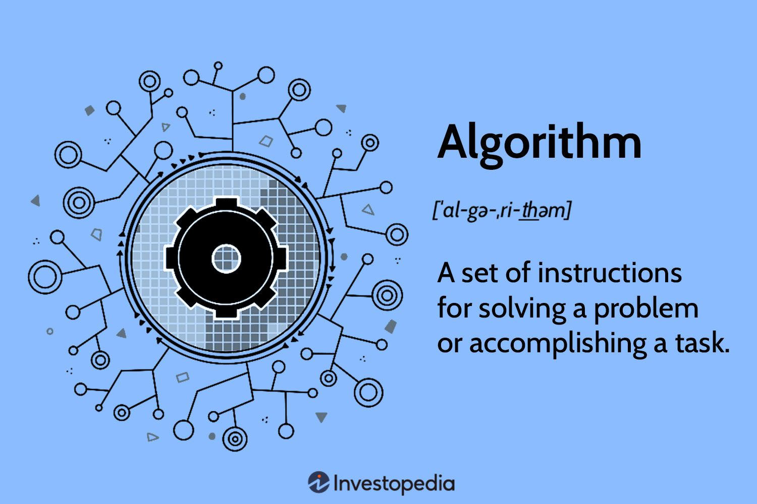
Algorithms
[Supervised Machine Learning Algorithms]
1. Logistic Regression
2. Decision Tree
3. Random Forest
4. Support Vector Machine
5. K-Nearest Neighbors
6. Naïve Bayes

Slide 16
1. Logistic Regression
Logistic regression is the appropriate regression analysis to conduct when the dependent variable is dichotomous (binary). Like all regression analyses, logistic regression is a predictive analysis. It is used to describe data and to explain the relationship between one dependent binary variable and one or more nominal, ordinal, interval or ratio-level independent variables.
Logistic regression is used for binary classification where we use sigmoid function, that takes input as independent variables and produces a probability value between 0 and 1.
For example, we have two classes Class 0 and Class 1 if the value of the logistic function for an input is greater than 0.5 (threshold value) then it belongs to Class 1 otherwise it belongs to Class 0. It’s referred to as regression because it is the extension of linear regression but is mainly used for classification problems.

Slide 17
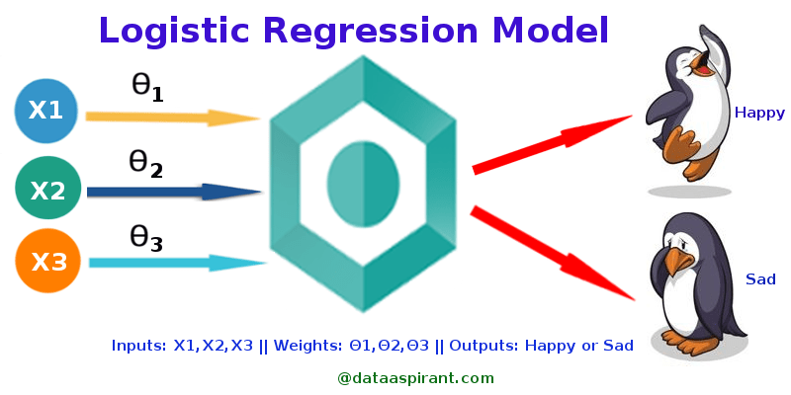
Logistic Regression

Slide 18
Types of Logistic regression : Binary logistic regression Binary logistic regression is used to predict the probability of a binary outcome, such as yes or no, true or false, or 0 or 1. For example, it could be used to predict whether a customer will churn or not, whether a patient has a disease or not, or whether a loan will be repaid or not. Multinomial logistic regression Multinomial logistic regression is used to predict the probability of one of three or more possible outcomes, such as the type of product a customer will buy, the rating a customer will give a product, or the political party a person will vote for. Ordinal logistic regression is used to predict the probability of an outcome that falls into a predetermined order, such as the level of customer satisfaction, the severity of a disease, or the stage of cancer.

Slide 19
Key Points:
Logistic regression predicts the output of a categorical dependent variable. Therefore, the outcome must be a categorical or discrete value.
It can be either Yes or No, 0 or 1, true or False, etc. but instead of giving the exact value as 0 and 1, it gives the probabilistic values which lie between 0 and 1.
In Logistic regression, instead of fitting a regression line, we fit an “S” shaped logistic function, which predicts two maximum values (0 or 1).

Slide 20
Logistic Function – Sigmoid Function
The sigmoid function is a mathematical function used to map the predicted values to probabilities.
It maps any real value into another value within a range of 0 and 1. The value of the logistic regression must be between 0 and 1, which cannot go beyond this limit, so it forms a curve like the “S” form.
The S-form curve is called the Sigmoid function or the logistic function.
In logistic regression, we use the concept of the threshold value, which defines the probability of either 0 or 1. Such as values above the threshold value tends to 1, and a value below the threshold values tends to 0.

Slide 21

Logistic Function – Sigmoid Function

Slide 22

2. Decision Tree A decision tree is a type of supervised learning algorithm that is commonly used in machine learning to model and predict outcomes based on input data. It is a tree-like structure where each internal node tests on attribute, each branch corresponds to attribute value and each leaf node represents the final decision or prediction. The decision tree algorithm falls under the category of supervised learning. They can be used to solve both regression and classification problems.

Slide 23
Decision Tree Terminologies
Root Node: A decision tree’s root node, which represents the original choice or feature from which the tree branches, is the highest node.
Internal Nodes (Decision Nodes): Nodes in the tree whose choices are determined by the values of particular attributes. There are branches on these nodes that go to other nodes.
Leaf Nodes (Terminal Nodes): The branches’ termini, when choices or forecasts are decided upon. There are no more branches on leaf nodes.
Branches (Edges): Links between nodes that show how decisions are made in response to particular circumstances.
Splitting: The process of dividing a node into two or more sub-nodes based on a decision criterion. It involves selecting a feature and a threshold to create subsets of data.
Parent Node: A node that is split into child nodes. The original node from which a split originates.
Child Node: Nodes created as a result of a split from a parent node.
Decision Criterion: The rule or condition used to determine how the data should be split at a decision node. It involves comparing feature values against a threshold.
Pruning: The process of removing branches or nodes from a decision tree to improve its generalisation and prevent overfitting.

Slide 24
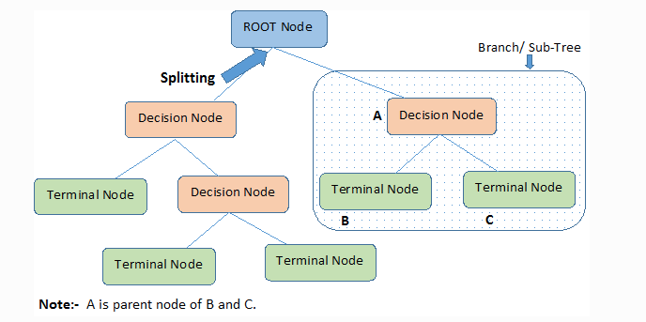
Decision Tree

Slide 25
How does the Decision Tree algorithm Work?
In a decision tree, for predicting the class of the given dataset, the algorithm starts from the root node of the tree. This algorithm compares the values of root attribute with the record (real dataset) attribute and, based on the comparison, follows the branch and jumps to the next node.
For the next node, the algorithm again compares the attribute value with the other sub-nodes and move further. It continues the process until it reaches the leaf node of the tree. The complete process can be better understood using the below algorithm:
Step-1: Begin the tree with the root node, says S, which contains the complete dataset.
Step-2: Find the best attribute in the dataset using Attribute Selection Measure (ASM).
Step-3: Divide the S into subsets that contains possible values for the best attributes.
Step-4: Generate the decision tree node, which contains the best attribute.
Step-5: Recursively make new decision trees using the subsets of the dataset created in step -3. Continue this process until a stage is reached where you cannot further classify the nodes and called the final node as a leaf node

Slide 26
Attribute Selection Measures:
While implementing a Decision tree, the main issue arises that how to select the best attribute for the root node and for sub-nodes. So, to solve such problems there is a technique which is called as Attribute selection measure or ASM. By this measurement, we can easily select the best attribute for the nodes of the tree. There are two popular techniques for ASM, which are:
1.Information Gain:
Information gain is the measurement of changes in entropy after the segmentation of a dataset based on an attribute.
It calculates how much information a feature provides us about a class.
According to the value of information gain, we split the node and build the decision tree.
A decision tree algorithm always tries to maximize the value of information gain, and a node/attribute having the highest information gain is split first. It can be calculated using the below formula:
Information Gain= Entropy(S)- [(Weighted Avg) *Entropy(each feature)

Slide 27
Entropy:
Entropy is a metric to measure the impurity in a given attribute. It specifies randomness in data. Entropy can be calculated as:
Entropy(s)= -P(yes)log2 P(yes)- P(no) log2 P(no)Where,
S= Total number of samples
P(yes)= probability of yes
P(no)= probability of no
2. Gini Index:
Gini index is a measure of impurity or purity used while creating a decision tree in the CART(Classification and Regression Tree) algorithm.
An attribute with the low Gini index should be preferred as compared to the high Gini index.
It only creates binary splits, and the CART algorithm uses the Gini index to create binary splits.
Gini index can be calculated using the below formula:
Gini Index= 1- ∑jPj2

Slide 28

3. Random Forest
We know that a forest comprises numerous trees, and the more trees more it will be robust. Similarly, the greater the number of trees in a Random Forest Algorithm, the higher its accuracy and problem-solving ability. Random Forest is a classifier that contains several decision trees on various subsets of the given dataset and takes the average to improve the predictive accuracy of that dataset. It is based on the concept of ensemble learning which is a process of combining multiple classifiers to solve a complex problem and improve the performance of the model.

Slide 29
Ensemble Techniques:
Ensemble simply means combining multiple models. Thus a collection of models is used to make predictions rather than an individual model.
Ensemble uses two types of methods:
Bagging
It creates a different training subset from sample training data with replacement & the final output is based on majority voting. For example, Random Forest.
Boosting
It combines weak learners into strong learners by creating sequential models such that the final model has the highest accuracy. For example, ADA BOOST, XG BOOST.

Slide 30
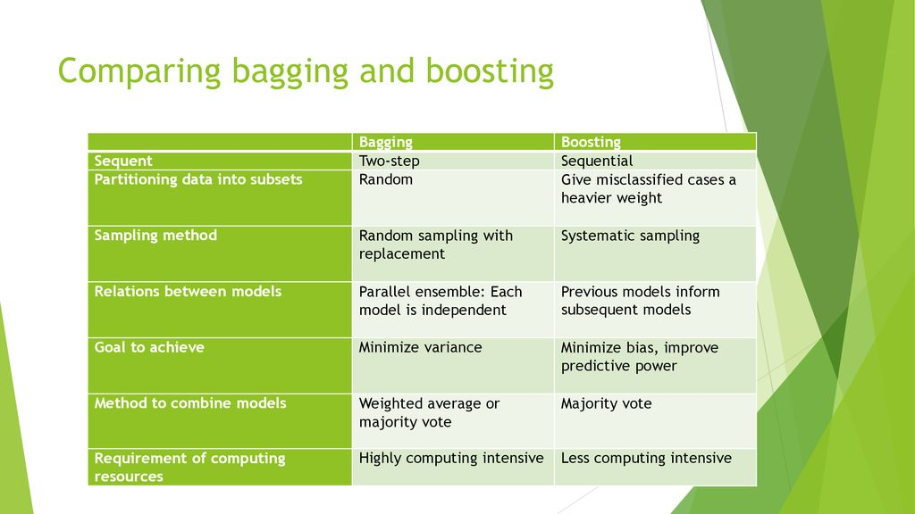

Slide 31
How to build Random Forest
Step 1: In the Random forest model, a subset of data points and a subset of features is selected for constructing each decision tree. Simply put, n random records and m features are taken from the data set having k number of records.
Step 2: Individual decision trees are constructed for each sample.
Step 3: Each decision tree will generate an output.
Step 4: Final output is considered based on Majority Voting or Averaging for Classification and regression, respectively.

Slide 32
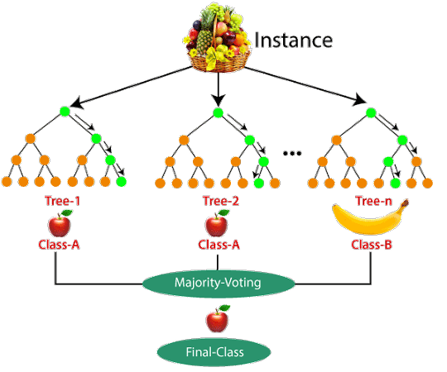

Slide 33
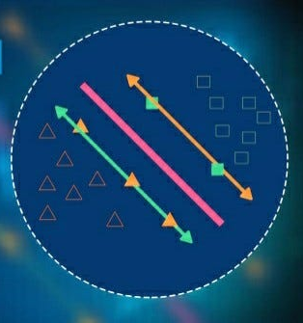
4.Support vector machine
Support Vector Machine (SVM) is a supervised machine learning algorithm used for both classification and regression. Though we say regression problems as well it’s best suited for classification. The main objective of the SVM algorithm is to find the optimal hyperplane in an N-dimensional space that can separate the data points in different classes in the feature space.

Slide 34
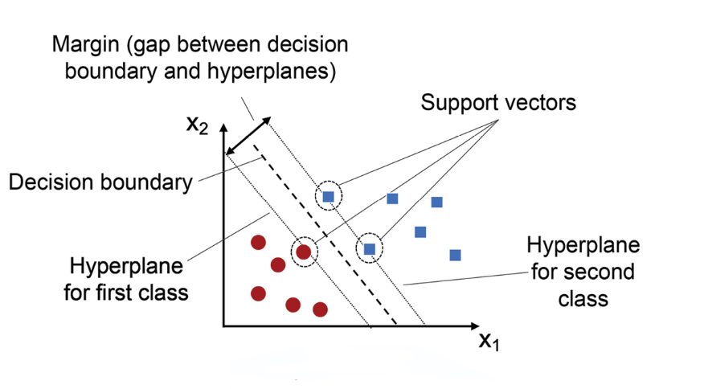

Slide 35
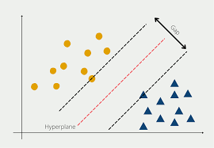
Support Vector Machine Terminology
Hyperplane: Hyperplane is the decision boundary that is used to separate the data points of different classes in a feature space.
When we plot the data points in a 2-dimensional graph we call decision boundary a straight line but if we have more dimensions, we call this decision boundary a “hyperplane”.
There can be multiple lines/decision boundaries to segregate the classes in n-dimensional space, but we need to find out the best decision boundary that helps to classify the data points. This best boundary is known as the hyperplane of SVM.

Slide 36
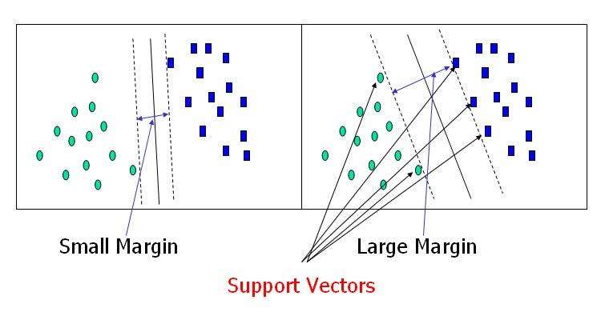
Support Vectors: Support vectors are the closest data points to the hyperplane, which makes a critical role in deciding the hyperplane and margin.
Margin: Margin is the distance between the support vector and hyperplane. The main objective of the support vector machine algorithm is to maximize the margin. The wider margin indicates better classification performance.

Slide 37
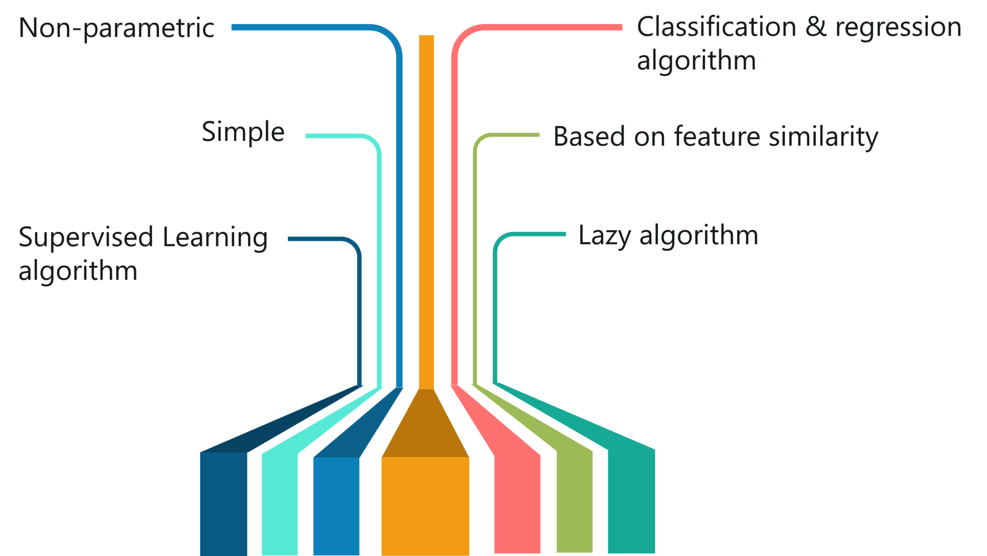
5.K-Nearest Neighbor:
K-Nearest Neighbors (KNN) is a simple and widely used machine learning algorithm for classification and
regression tasks. It belongs to the category of instance-based, lazy learning algorithms, meaning it
doesn't learn a specific model during training. Instead, it memorizes the training dataset and makes
predictions based on the similarity between new instances and previously seen instances.

Slide 38
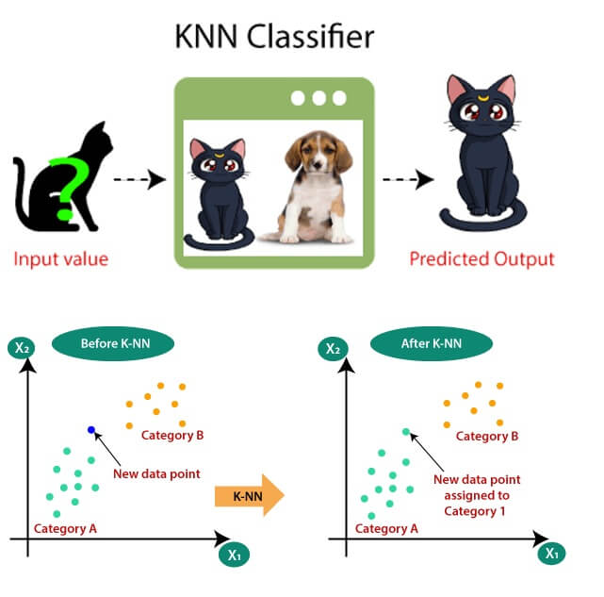
How does KNN work?

Slide 39
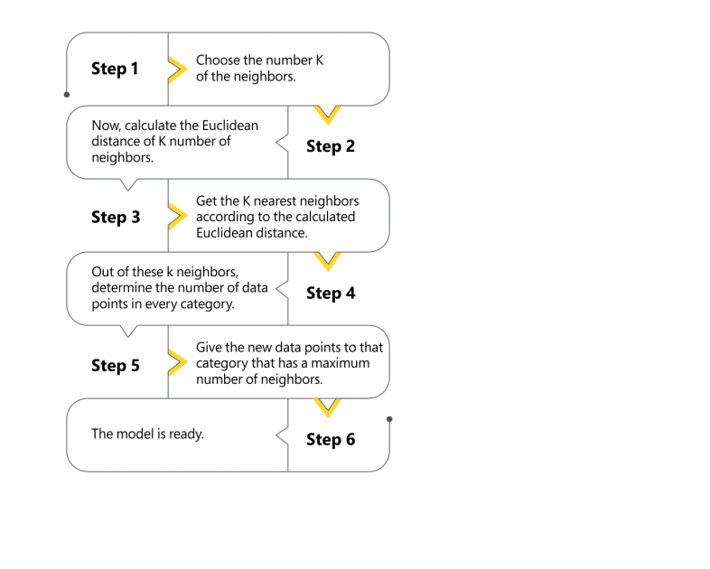

Slide 40

6.Naïve Bayes
Naive Bayes classifier is a probabilistic machine learning model based on Bayes’ theorem. It assumes independence between features and calculates the probability of a given input belonging to a particular class. It’s widely used in text classification, spam filtering, and recommendation system.
The Naïve Bayes algorithm is comprised of two words Naïve and Bayes, Which can be described as:
Naïve: It is called Naïve because it assumes that the occurrence of a certain feature is independent of the occurrence of other features.
Bayes: It is called Bayes because it depends on the principle of Bayes' Theorem.

Slide 41
Bayes’ Theorem:
Bayes’ Theorem finds the probability of an event occurring given the probability of another event that has already occurred. Bayes’ theorem is stated mathematically as the following equation:
P(A∣B)=P(B∣A)P(A)​
P(B)
where A and B are events and P(B) ≠ 0
P(A|B) is Posterior probability: Probability of hypothesis A on the observed event B.
P(B|A) is Likelihood probability: Probability of the evidence given that the probability of a hypothesis is true.
P(A) is Prior Probability: Probability of hypothesis before observing the evidence.
P(B) is Marginal Probability: Probability of Evidence.

Slide 42
Specification of the system
GPU RAM 4 GB
System RAM 8 GB
CPU Intel(R) Core(TM) i5-8350U CPU @ 1.70GHz 1.90 GHz
Language Python 3.11.9
Name Parameter

Slide 43
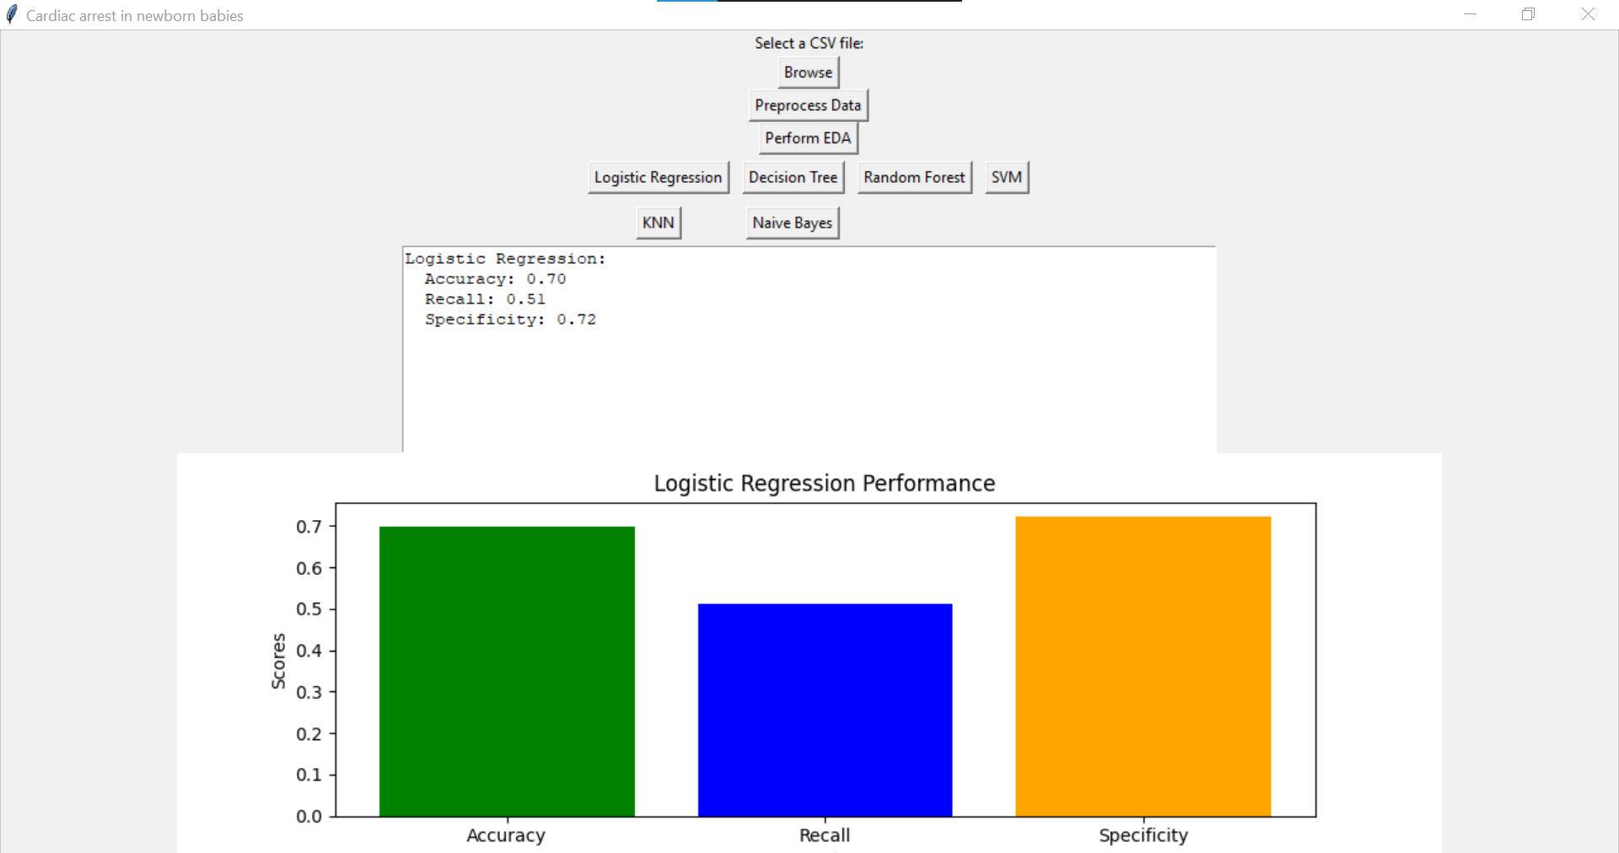

Insights:

Slide 44
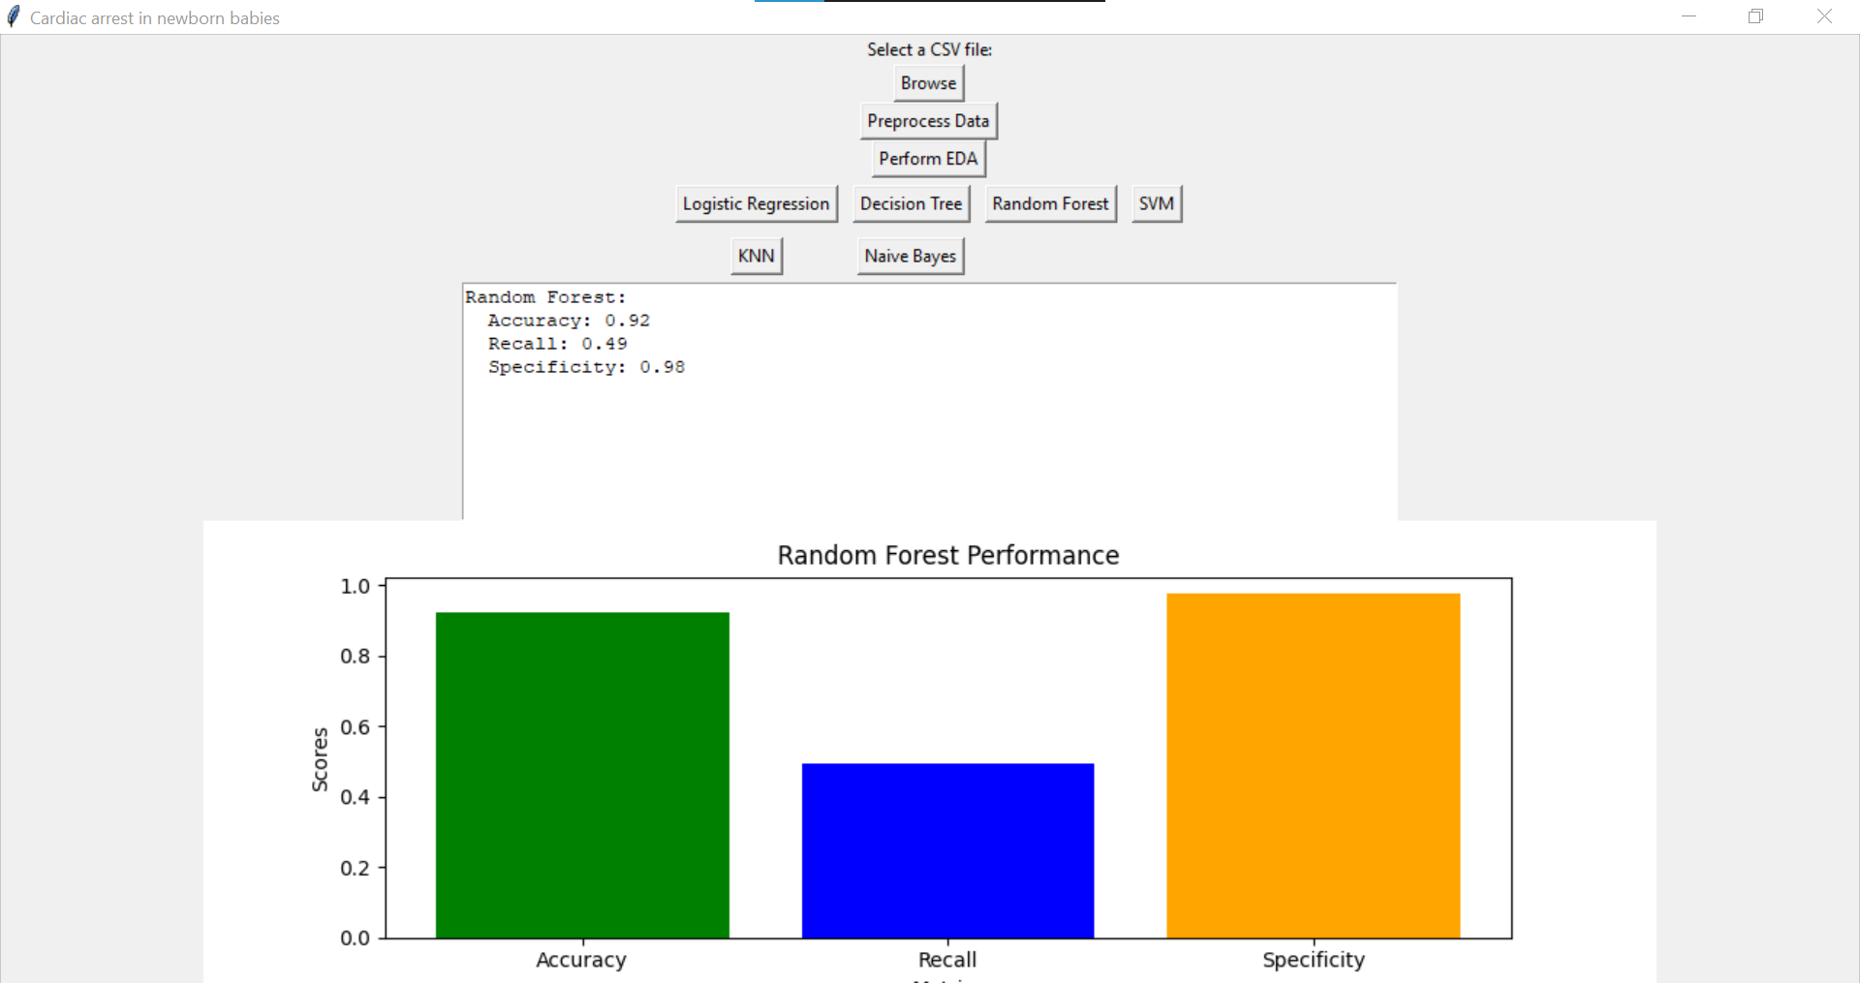
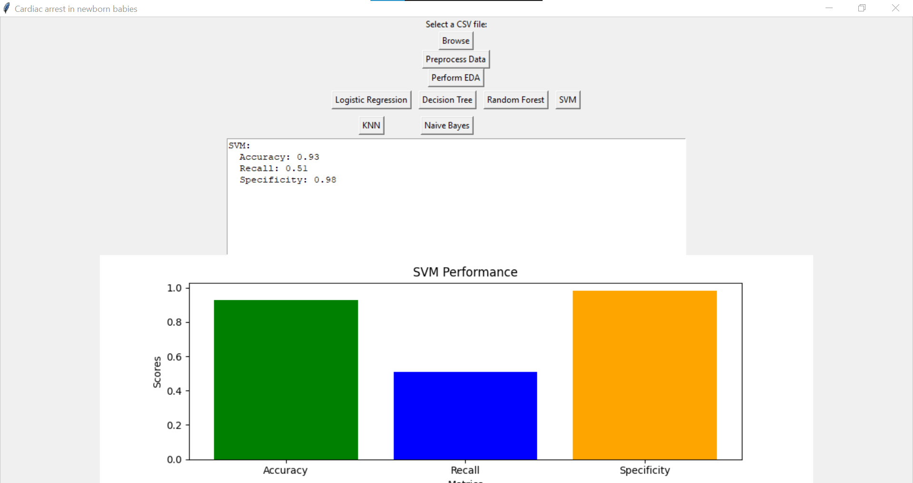

Slide 45
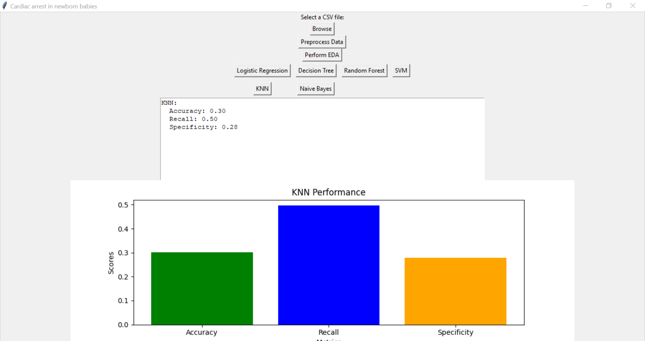


Slide 46
The ml-based model that is being given here is essential for accurately and efficiently identifying infants who are at high risk of cardiac arrest, which is necessary for early detection of cardiac arrest in neonates in the CICU. These models are able to recognize minute variations in vitals, such heart, and breathing rates, which could point to an impending cardiac arrest. The suggested model attained high values for multiple assessment criteria in a training comparative region. It maintained its good performance in a testing comparative region, suggesting that it is useful for detecting infants who are at risk. Identifying cardiac arrest early allows early intervention, potentially preventing a tragic outcome. It can also reduce the time an infant living in CICU, leading to cost savings and better outcomes. Additionally, the model could be used to predict potential complications in fetuses or newborns, improving prenatal care. Finally, it could be used to improve diagnostics and treatments by providing doctors with more accurate information. This could lead to better patient outcomes and more cost-effective treatments.
CONCLUSION

Slide 47
[1] M. M. Ahsan and Z. Siddique, ‘‘Machine learning-based heart disease diagnosis: A systematic literature review,’’ Artif. Intell. Med., vol. 128, Jun. 2022, Art. no. 102289. [2] C. Krittanawong, H. Zhang, Z. Wang, M. Aydar, and T. Kitai, ‘‘Artificial intelligence in precision cardiovascular medicine,’’ J. Amer. College Cardiol., vol. 69, no. 21, pp. 2657–2664, 2017. [3] K. W. Johnson, J. T. Soto, B. S. Glicksberg, K. Shameer, R. Miotto, M. Ali, E. Ashley, and J. T. Dudley, ‘‘Artificial intelligence in cardiology,’’ J. Amer. College Cardiol., vol. 71, pp. 2668–2679, Jun. 2018. [4] M. Saeed, M. Villarroel, A. T. Reisner, G. Clifford, L.-W. Lehman, G. Moody, T. Heldt, T. H. Kyaw, B. Moody, and R. G. Mark, ‘‘Multiparameter intelligent monitoring in intensive care II: A public-access intensive care unit database*,’’ Crit. Care Med., vol. 39, no. 5, pp. 952–960, May 2011 [5] T. J. Pollard, A. E. W. Johnson, J. D. Raffa, L. A. Celi, R. G. Mark, and O. Badawi, ‘‘The eICU collaborative research database, a freely available multi-center database for critical care research,’’ Sci. Data, vol. 5, no. 1, pp. 1–13, Sep. 2018
REFERENCES

